Slide 1


Participatory Design
Miguel Castillo
Notes:
Hi everyone, thank you for being here today. In this session, I'll be presenting on Participatory Design. As you may recall my previous presentation focused on Contextual Design, so I’d like to continue exploring design approaches. In this presentation, I’ll provide an overview of Participatory Design—its background, key principles, and practical applications.

Slide 2


What is Participatory Design?
A collaborative design approach that involves end users in the design process.
Users take an active role in the design process, rather than just testing solutions, being observed, or interviewed.
Users bring more diversity and expertise
Helps build buy in, satisfaction, and confidence among end users
Aka
Co-design
Cooperative design
Community design
Notes:
Gathered this definition from the IDF website, just like I did for Contextual Design. I found that this website overall provided clear and direct definitions. By the way, it's a great resource for any other design and research topics or content.
So the way they define, Participatory design, is as a collaborative design approach that involves end-users in the design process. Its aim is to create products and services that better meet the needs and expectations of users by applying their knowledge and experiences.
This may sound similar to contextual design and/or user centered design, covered last week.
However, in this approach, users take an active role in the design process, rather than just testing solutions (that have been solely developed by designers), being observed or interviewed (by researchers to gather insights). Participatory Design gives users the opportunity to help figure out and co-design solutions, most commonly during the design stage.
Participatory Design is not just about bringing users to do the work of the designer, but rather it’s another way to help designers understand the users with the end goal of creating products and services that accommodate their needs and help them achieve their objectives.
This approach helps bring in more diversity—and more expertise—to the design process. In addition, it can help build buy-in among end users, and it can lead to higher satisfaction and confidence in the end product as the users get to see their feedback and suggestions come alive.

Slide 3
Background
Emerged in Scandinavia in the 1970s
In response to top-down approach
Involve workers in designing and organizing their work environment
Create more humane and efficient work systems
"..in many ways, participatory design is how humans naturally go about solutions. In one way or another, it has been around as long as humans have.” - Victor Udoewa, Research Design Lead at NASA
Notes:
This design approach emerged in Scandinavia in the 1970s. This movement came as a response to traditional top-down approaches to design, which often resulted in products that did not address the needs and preferences of end-users.
The goal was to create more humane and efficient work systems that catered to the needs of the workers, rather than forcing them to adapt to poorly designed systems.
Over time, participatory design has evolved to encompass a wide range of industries, including software and product design, urban planning, architecture, graphic design, and even healthcare.
Now, that is not to say that this approach of involving users in the design process was not done before
Research Design lead from NASA suggests "..in many ways, participatory design is how humans naturally go about solutions. In one way or another, it has been around as long as humans have."

Slide 4
Key Principles
Co-creation
Democratization of design
Empathy and understanding
Iterative process
Transparency
Flexibility
Notes:
Moving on, we have the key principles designers should adhere to for participatory design
Co-creation: Designers and users work together to identify problems and develop solutions, ensuring that the final product meets user needs effectively.
Democratization of design: This principle gives all stakeholders, especially users, a voice in the design process, challenging the traditional notion that design decisions should solely rest with professionals.
Empathy and understanding: Understanding users' experiences, needs, and contexts through direct engagement, fosters a deep empathy that informs design choices.
Iterative process: Ideas are continuously refined and tested with users, allowing for adjustments based on feedback.
Transparency: Participants understand how decisions are made, fostering trust and collaboration.
Flexibility: Design remains flexible to adapt to new insights and challenges that arise during the process.

Slide 5
Participatory Design Benefits
Improve user satisfaction
Increased user engagement
Improved innovation
Increased social inclusion
Reduce development cost
Notes:
Now, just like with any design approach, you have your benefits and challenges.
Improved user satisfaction: When designers involve users in the design process, they get a deeper understanding of user needs and preferences that they may have otherwise overlooked, which can lead to a better user experience.
Increased user engagement: When users participate in the design process, they are more likely to feel invested in the final product, service, or system. This participation can lead to increased user engagement and greater ownership over the outcome.
Reduced development costs: Users involved in the design process will help designers catch potential issues before they become costly problems. Participatory design can help identify design flaws early in the process, saving time and money in the long run.
Improved innovation: Users often have unique perspectives and ideas that can lead to breakthroughs in design. Participatory design helps designers gain insights into new and innovative problem-solving methods..
Increased social inclusion: Participatory design can help to ensure that products, services, or systems are accessible and inclusive to all users, including those who might otherwise be marginalized or excluded.

Slide 6
Participatory Design Challenges
Effective Communication
Balancing expertise and user input
Representation
Time and resources
Notes:
Effective communication: Establish clear communication channels and guidelines to manage and harmonize diverse opinions and expectations from various stakeholders.
Balance expertise and input: Value each participant's input, but also guide the process with professional expertise to maintain focus and direction.
Representation: Carefully select participants to ensure a broad representation of user types. Avoiding bias towards any particular group. This diversity helps to address a wide range of needs and perspectives.
Time and resources: Plan for the extra time and resources participatory design may require. This may involve setting realistic timelines and budgets that account for the iterative nature of participatory processes.

Slide 7
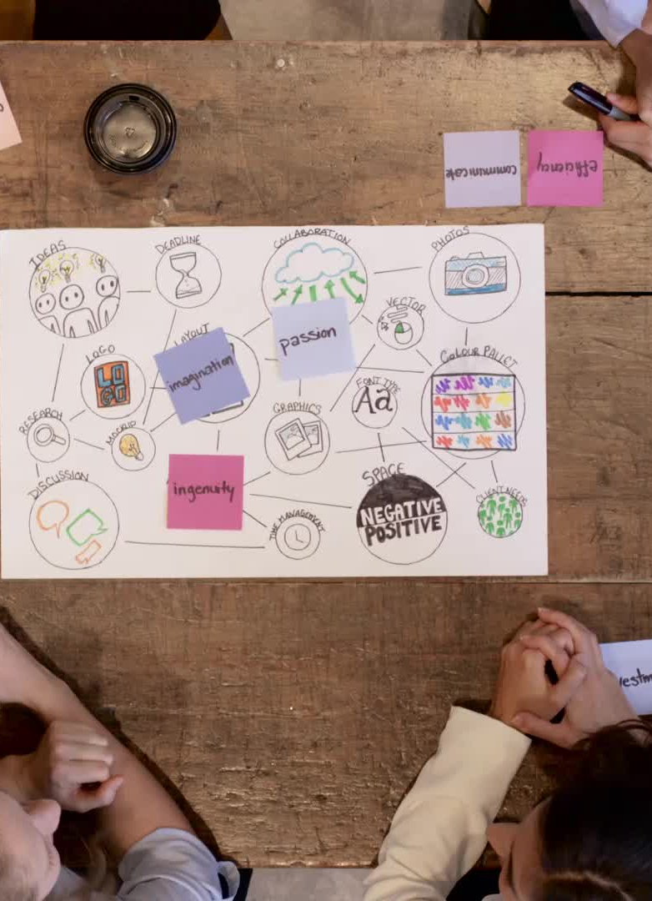
Implementing Participatory Design
Focus groups, workshops, co-design sessions
Brainstorming ideas
Co-designing concepts
Journey maps
Storyboards
Notes:
As mentioned, the most common use of participatory design is during the design phase, but you can co-design with users during any stage, including in the discovery phase.
When involving users in the design phase, there’s a general understanding of the issue that needs to be solved, and a solution needs to be developed.
There are many approaches and activities within co-designing, each one with different outcomes.
Depending on what do you want to learn or achieve (e.g., generate ideas, generate prototype, validate concepts, refine prototypes) – the process will look different
The general idea is to bring users together along designers in shared spaces where they can collaborate
A couple ways to do so is via focus group sessions, workshops, or co-design sessions
Here:
Users and designers can collaborate to explore ideas and solutions. These can include brainstorming solutions, coming up with sketches/concepts, or even developing journey maps and or storyboards
Understanding how users would solve a challenge they face directly often surfaces new insights about their experiences. Either by validating or invalidating any ideas
As an example, with journey maps:
Journey maps:
Users can map out their current experiences or provide input into a journey map developed from previous research to get richer information by extracting it within the context of an entire experience, rather than asking about the issues as a standalone exercise.

Slide 8

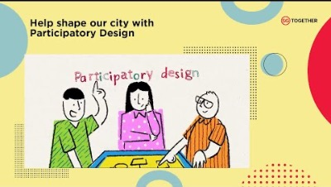



Participatory Design Example

Slide 9
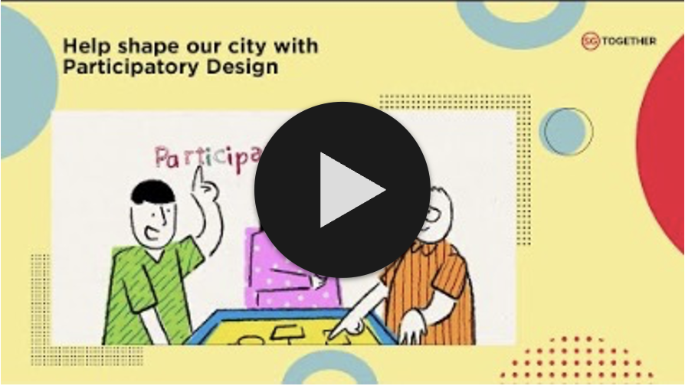
Participatory Design Example
Notes:
As you can see participatory design, doesn’t only apply to the development of digital products and it’s not a linear rigid step by step process.

Slide 10

Thank You
Thank you very much for your time! If you have any questions, please contact me via - cast4317@vandals.uidaho.edu

Slide 11
References
Interaction Design Foundation - IxDF. (2023, March 17). What is Participatory Design?. Interaction Design Foundation - IxDF. https://www.interaction-design.org/literature/topics/participatory-design
Anderson-stanier, n. (2021, December 16). Come together: including participatory design in your research process. dscout.com. https://dscout.com/people-nerds/participatory-design#:~:text=The%20most%20common%20use%20of,the%20best%20tools%20to%20use.
Cipan, V., & Anic, I. (2023, March 29). Participatory design: everything you need to know about it and how to use it. Point Jupiter. https://pointjupiter.com/what-is-participatory-design-what-makes-it-great/
Elizarova, O., & Dowd, K. (2017, December 14). Participatory design in practice. UX Magazine. https://uxmag.com/articles/participatory-design-in-practice
Krasovskaya, D. (2024, September 8). Participatory Design: The Complete guide. UXtweak. https://blog.uxtweak.com/participatory-design/
Our SG - Home of Forward SG. (2022, August 31). Help shape our city with participatory design [Video]. YouTube. https://www.youtube.com/watch?v=PmLUOptcxzg

